Slide 1
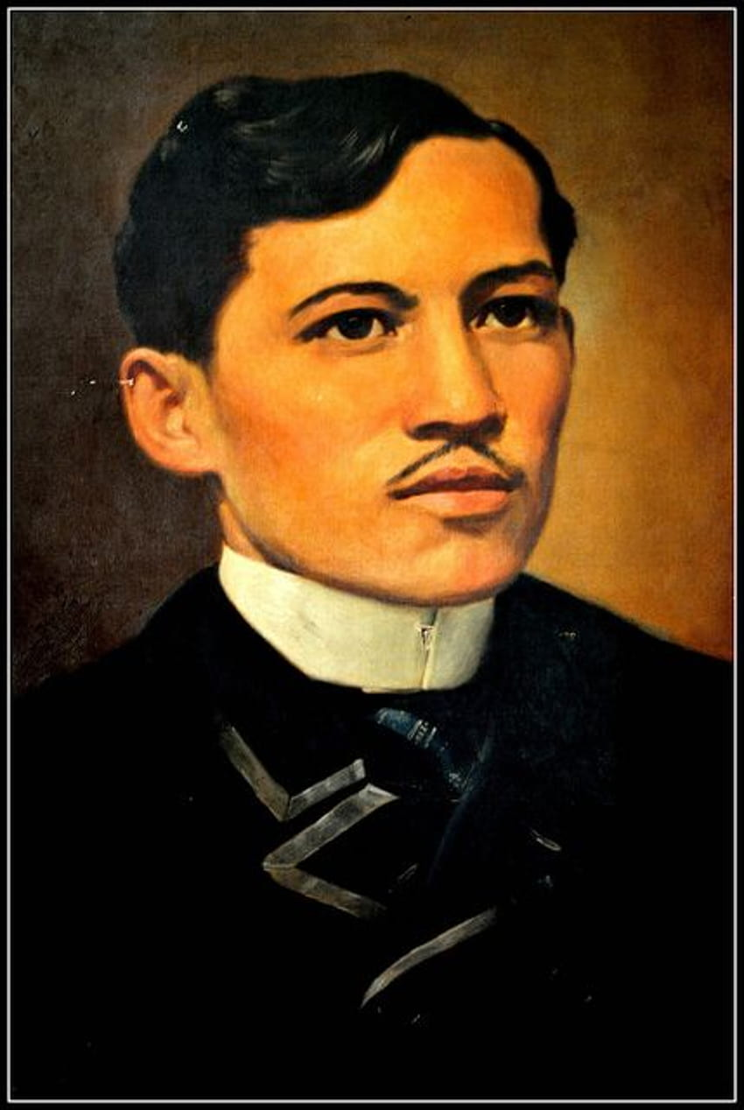

GEDC 1014 (JRIZAL)
RIZAL LAW (RA 1425)

Slide 2
INTRODUCTION
Rizal Law or Republic Act 1425 stands as a pivotal piece of legislation in the Philippines aimed at fostering a sense of national identity and patriotism among Filipinos.
Enacted in 1956, the law mandates the inclusion of courses on the life, works, and writings of José Rizal, particularly his seminal novels Noli Me Tangere and El Filibusterismo, in the curricula of all public and private educational institutions.

Slide 3
INTRODUCTION
The legislation emerged during a period of heightened national consciousness and was championed by prominent figures such as Senator Claro M. Recto and Senator José P. Laurel.
Despite facing significant opposition, particularly from the Catholic Church, the Rizal Law was passed to ensure that Rizal's ideals and principles continue to inspire future generations.
The topic discussions delve into the key aspects of the Rizal Law, its historical development, and its implementation in the Philippine education system, highlighting its enduring significance.

Slide 4
WHAT IS RIZAL LAW?
Rizal Law (RA 1425) mandates the inclusion of courses on the life, works, and writings of José Rizal in the curricula of all public and private schools, colleges, and universities in the Philippines.
The law specifically requires the study of Rizal's novels Noli Me Tangere and El Filibusterismo, which are considered instrumental in awakening Filipino nationalism and fostering a sense of identity and patriotism among the youth.
The law aims to honor Rizal's contributions to Philippine history and ensure that his ideals and principles continue to inspire future generations.

Slide 5
HISTORY AND DEVELOPMENT OF RIZAL LAW
The Rizal Law was enacted on June 12, 1956, during the administration of President Ramon Magsaysay.
The bill was primarily authored by Senator Claro M. Recto and co-authored by Senator José P. Laurel.
The proposal faced significant opposition, particularly from the Catholic Church, which objected to the anti-clerical themes present in Rizal's novels.

Slide 6
HISTORY AND DEVELOPMENT OF RIZAL LAW
Despite the intense debates and resistance, the proponents of the bill argued that the study of Rizal's works was essential for fostering a sense of national pride and consciousness.
The bill was eventually passed with a provision allowing students to be exempted from reading the unexpurgated versions of the novels for religious reasons, provided they submit a sworn written statement.

Slide 7
WHY DO WE HAVE RIZAL LAW?
The promulgation of the Rizal Law is a result of various factors that stem from the search of Filipinos for their identity as a nation. In particular, the following key factors served as the fuel for the creation of this law:
Promotion of Nationalism and Patriotism
Educational Reform
Counteracting Colonial Mentality
Response to Contemporary Issues

Slide 8
WHY DO WE HAVE RIZAL LAW?
Promotion of Nationalism and Patriotism
During the mid-20th century, the Philippines was in a period of nation-building and seeking to strengthen its national identity.
The government recognized the importance of instilling a sense of nationalism and patriotism among Filipinos, especially the youth.
José Rizal, as a national hero, symbolized the struggle for freedom and the fight against colonial oppression. His works, particularly Noli Me Tangere and El Filibusterismo, were seen as powerful tools to inspire and educate Filipinos about their history and the values of justice, equality and freedom (the sense of democracy)

Slide 9
WHY DO WE HAVE RIZAL LAW?
Educational Reform
The Rizal Law aimed to reform the educational system by incorporating the study of Rizal's life and works into the curriculum.
This was intended to provide the Filipino youth with deeper understanding of the historical context of the Philippines and the contributions of Rizal to the country's independence movement.
By studying Rizal's writings, the youth would be encouraged to think critically about social and political issues and develop a sense of civic responsibility in building a nation for pride, respecting for human dignity and peace.

Slide 10
WHY DO WE HAVE RIZAL LAW?
Counteracting Colonial Mentality
The Philippines had been under Spanish, American, and Japanese colonial rule for centuries, which had a profound impact on the Filipino psyche.
There was a need to counteract the colonial mentality that had developed over time and to promote a sense of pride in Filipino heritage and identity.
The Rizal Law sought to achieve this by highlighting Rizal's achievements and sacrifices, thereby fostering a sense of pride and self-worth among Filipinos.

Slide 11
WHY DO WE HAVE RIZAL LAW?
Response to Contemporary Issues
During the 1950s, the Philippines faced various social and political challenges, including corruption, inequality, and a lack of national unity.
The proponents of the Rizal Law believed that by studying Rizal's works, Filipinos could draw lessons from the past and apply them to contemporary issues.
Rizal's advocacy for peaceful reform, education, and civic virtues was seen as relevant and necessary for addressing the problems of the time.

Slide 12
IMPLEMENTATION OF RIZAL LAW
IN THE PHILIPPINES
The implementation of the Rizal Law involves the integration of Rizal's life and works into the educational curriculum at various levels.
The Board of National Education was tasked with creating and distributing appropriate primers, readers, and textbooks to facilitate the teaching of Rizal's works.
Educational institutions are required to use the original or unexpurgated editions of Noli Me Tangere and El Filibusterismo or their English translations as basic texts in collegiate courses.
The law also mandates the printing and distribution of Rizal's works to ensure accessibility for educational purposes.

Slide 13
IMPLEMENTATION OF RIZAL LAW
IN THE PHILIPPINES
The impact of the Rizal Law has been significant in promoting a deeper understanding of Philippine history and the values of freedom, justice, and equality.
By studying Rizal's works, students gain insights into the struggles and aspirations of Filipinos during the Spanish colonial period, fostering a sense of national identity and pride.
The law continues to be a vital component of the Philippine education system, ensuring that Rizal's legacy remains relevant and influential in shaping the minds of the youth.

Slide 14
REFERENCES
Republic Act 1425
Revilla, B. (1956). The Rizal Bill: A happy compromise? Panorama 8(5), 1-4. Manila: Community Publishers.
Schumacher, J. (2011). The Rizal Bill of 1956: Horacio de la Costa and the Bishops. Philippine Studies 59(4), 529-553. https://muse.jhu.edu/article/459188

Slide 15
